Slide 1
Wrangling Docker and Python
Leveraging Containerization to quickly Deliver Python Solutions
John Carnell Genesys
Notes:
Explore and validate whether Unikernels are a viable option for use in PureCloud.
We are use unikernels to reduce deployment times for services

Slide 2

About the Speaker
JOHN CARNELL is a lead cloud engineer at Genesys, where he works in Genesys’s PureCloud division. John spends the majority of his day hands-on building telephony-based microservices using the AWS platform. His day-to-day job is designing and building microservices across a number of technology platforms including Java, Clojure, Python, and Go.
John is a prolific speaker and writer. He regularly speaks at local user groups and has been a regular speaker on the “The No Fluff Just Stuff Software Symposium.” Over the last 20 years, John has authored, co-authored, and been a technical reviewer for a number of Java-based technology books and industry publications.
John holds a Bachelor of the Arts (BA) from Marquette University and a Masters of Business Administration (MBA) from the University of Wisconsin Oshkosh.
John can be reached at john_carnell@yahoo.com

Slide 3
Agenda
What is a microservice?
Building a Simple Python Microservice Using Flask
What is Docker?
Moving beyond the simple service
Deploying Multiple Services
Operationalizing Docker
Beyond running your own containers
Note: All code can be found at https://github.com/carnellj/spmia-chapter[1-10]
Notes:
How many of you guys are actively building microservice based applications
How many of you guys are Spring developers
Building them in the cloud

Slide 4
What is a Microservice?

Slide 5
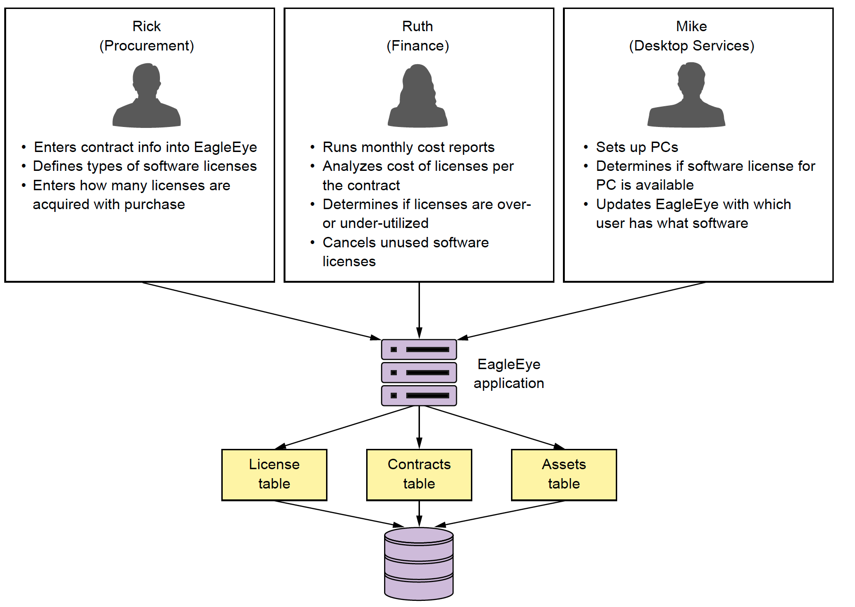
Lets build a Microservice: Start with a Problem
Notes:
Lets set the tone for the talk by setting the business problem. We have a small software company that makes licsense and asset management application. There traditional focus has been deliverying a monolithic web app, install on-premise to customers. They have a twice a year release cycle and it is killing the company in terms of getting the product out the door.

Slide 6
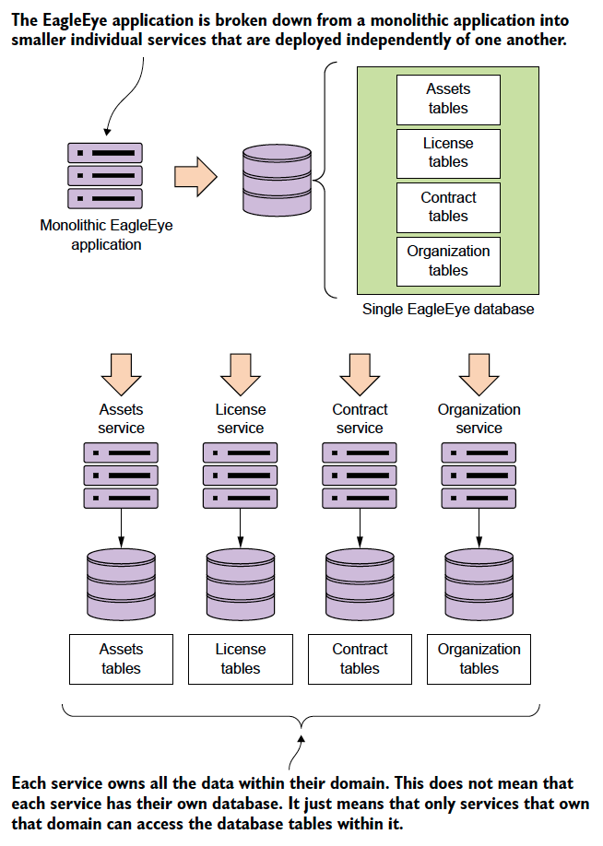
What is a Microservices: Decomposing the problem
Microservice are small, distributed software components that are:
Independently developed, tested and deployed from other software components in an application.
Are built around evolved principles (REST, JSON) rather then committee-based standards (No XML)
Very limited in scope of responsibility
Completely own their data
Are usually deployed in a loosely coupled fashion with synchronous and asynchronous interfaces
Their small size allows for rapid development and deployment of new features
Microservices are really a nature extension to the Agile and Lean movement shaping the software industry over the last 15 years
Microservices are pushing us to smaller batch sizes!
Notes:
To transition: Building microservices are easy. Its like building blog site in 10 minutes. :-)

Slide 7
Building your first Microservices with Python and Flask

Slide 8
Building your first Microservices with Python and Flask

Slide 9
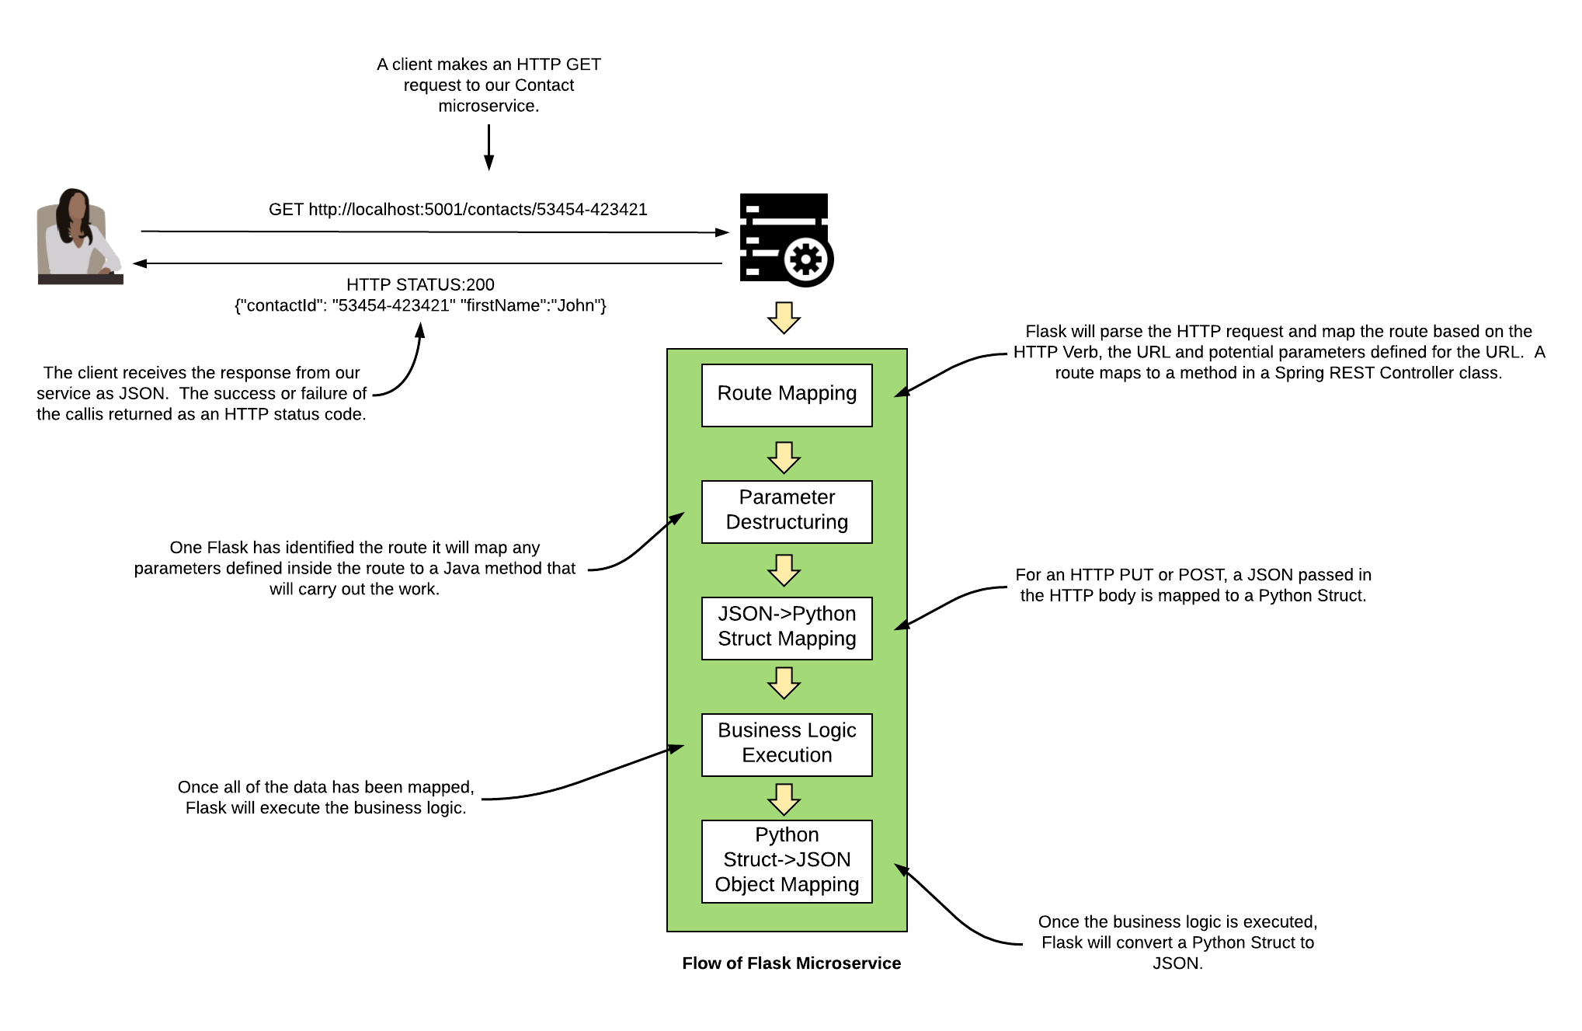
Lets build a simple microservice with Flask
What is Flask?
A very small HTTP-based web-service
Focuses heavily on building JSON-based, REST services
Annotation driven
Handles the most basic HTTP requests.
Notes:
Spring Boot really simplifies development of REST-based services by focusing on annotation development. Spring MVC is a full blown, full stack web development framework. Spring Boot is a very light weight framework

Slide 10
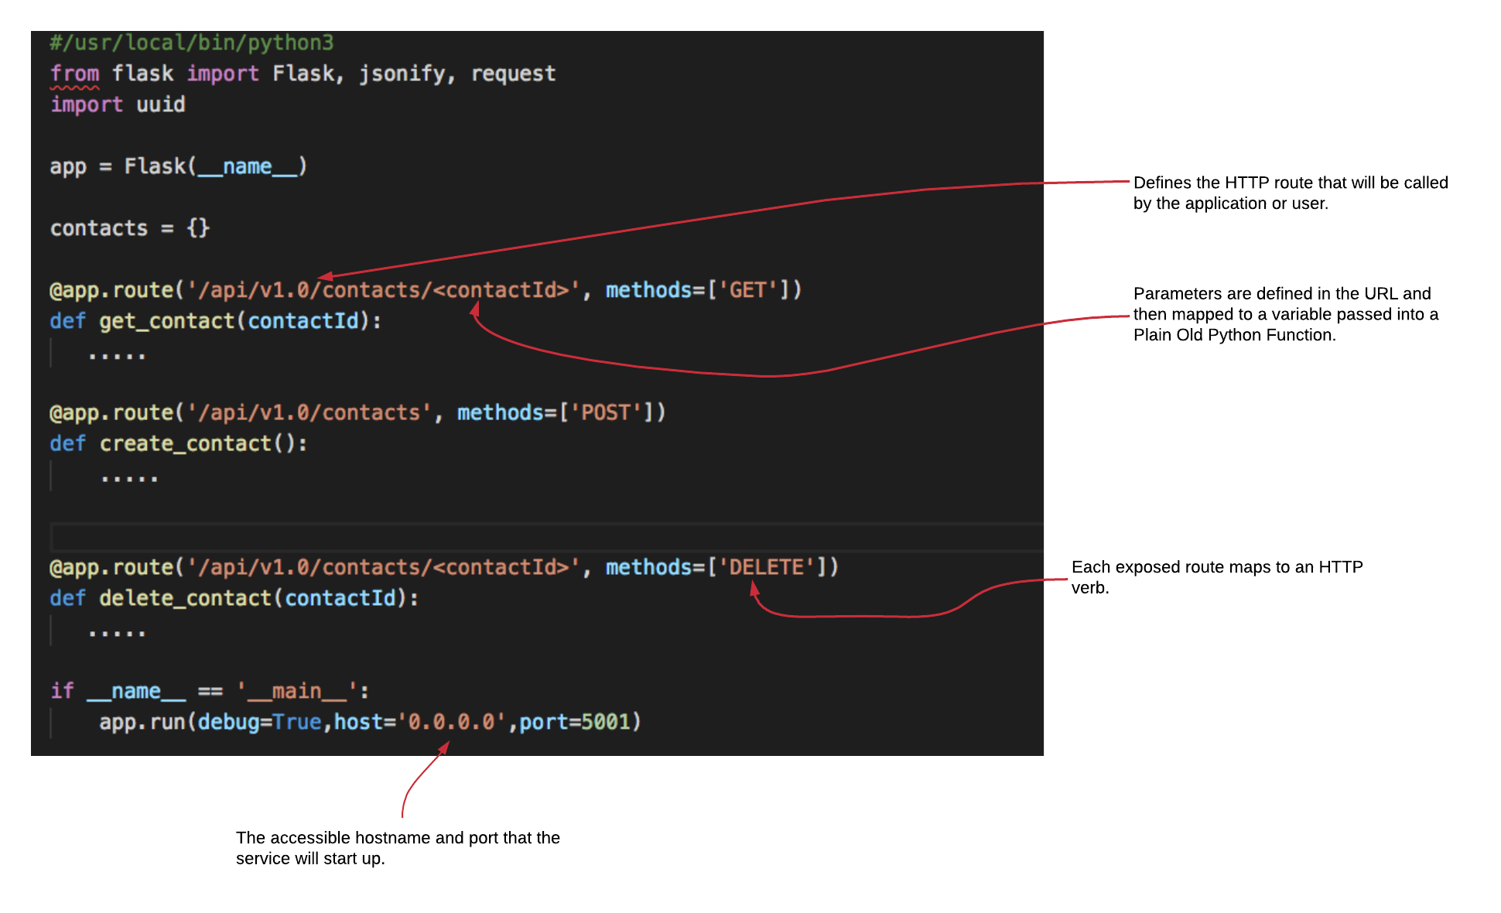
A Simple Contact Service

Slide 11
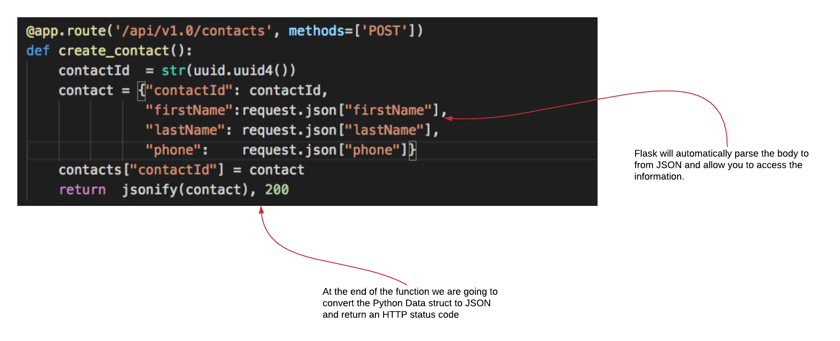
Creating a Contact with a POST

Slide 12
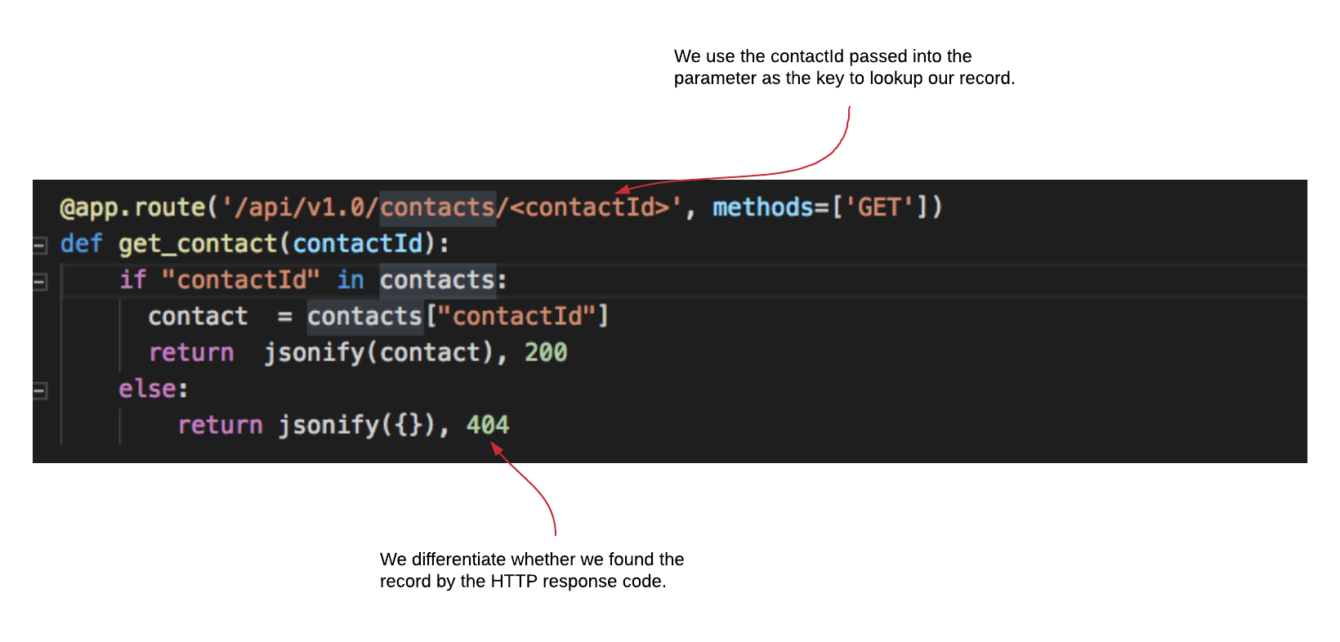
Retrieving a Contract with an HTTP

Slide 13
What is Docker?

Slide 14
What is Docker?
Docker is a container management platform
A container is a software image that is:
Lightweight
Stand-alone
Isolated
Portable across all environments
You run the same image across all environments
Notes:
Start with the story of 12000 configuration files and websphere. Configuration drift is really.
I cant stress this enough. How you manage the configuration of your application is critical. A microservice is a small independent piece of code that is self-contained and can be deployed quickly and repeatedly. It should be immutable meaning the server should not be touched

Slide 15
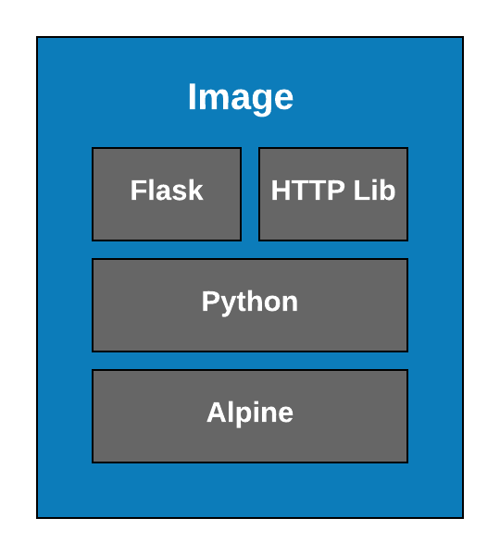
Everything in Docker Starts with An Image
Images are the self-contained, executables
You can start up an image
Once the image is baked it can not be changed
You can pass in environment variables to control behavior
Images are not full blown virtual machines
Best way to think about an image is that they do one thing really well.
Notes:
Start with the story of 12000 configuration files and websphere. Configuration drift is really.
I cant stress this enough. How you manage the configuration of your application is critical. A microservice is a small independent piece of code that is self-contained and can be deployed quickly and repeatedly. It should be immutable meaning the server should not be touched

Slide 16
How Do We Create an Image?
FROM python:3.6
RUN mkdir -p /usr/local/bin/simple-contact/
COPY requirements.txt /usr/local/bin/simple-contact/.
COPY contact.py /usr/local/bin/simple-contact/.
COPY DB.py /usr/local/bin/simple-contact/.
RUN pip3 install -r /usr/local/bin/simple-contact/requirements.txt
CMD python3 /usr/local/bin/simple-contact/simple-contact.py
docker build . –t simple-contact
Notes:
Start with the story of 12000 configuration files and websphere. Configuration drift is really.
I cant stress this enough. How you manage the configuration of your application is critical. A microservice is a small independent piece of code that is self-contained and can be deployed quickly and repeatedly. It should be immutable meaning the server should not be touched

Slide 17
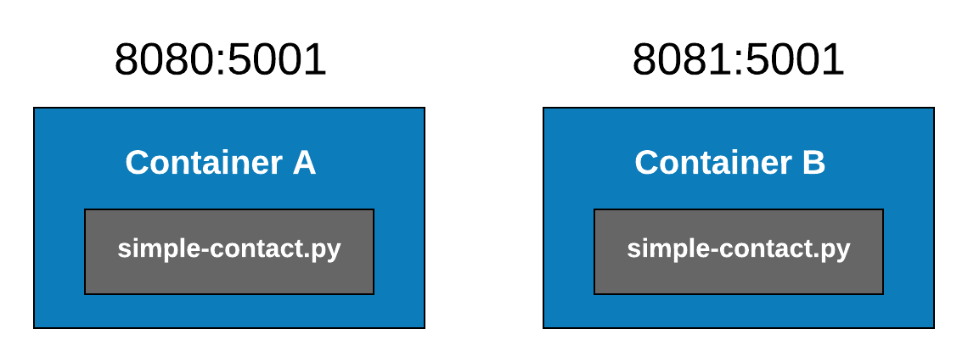
Great I have an image! Now what?
1
docker run -d --restart=always -p 8080:5001 simple-contact
X

Slide 18
Moving beyond a simple service

Slide 19
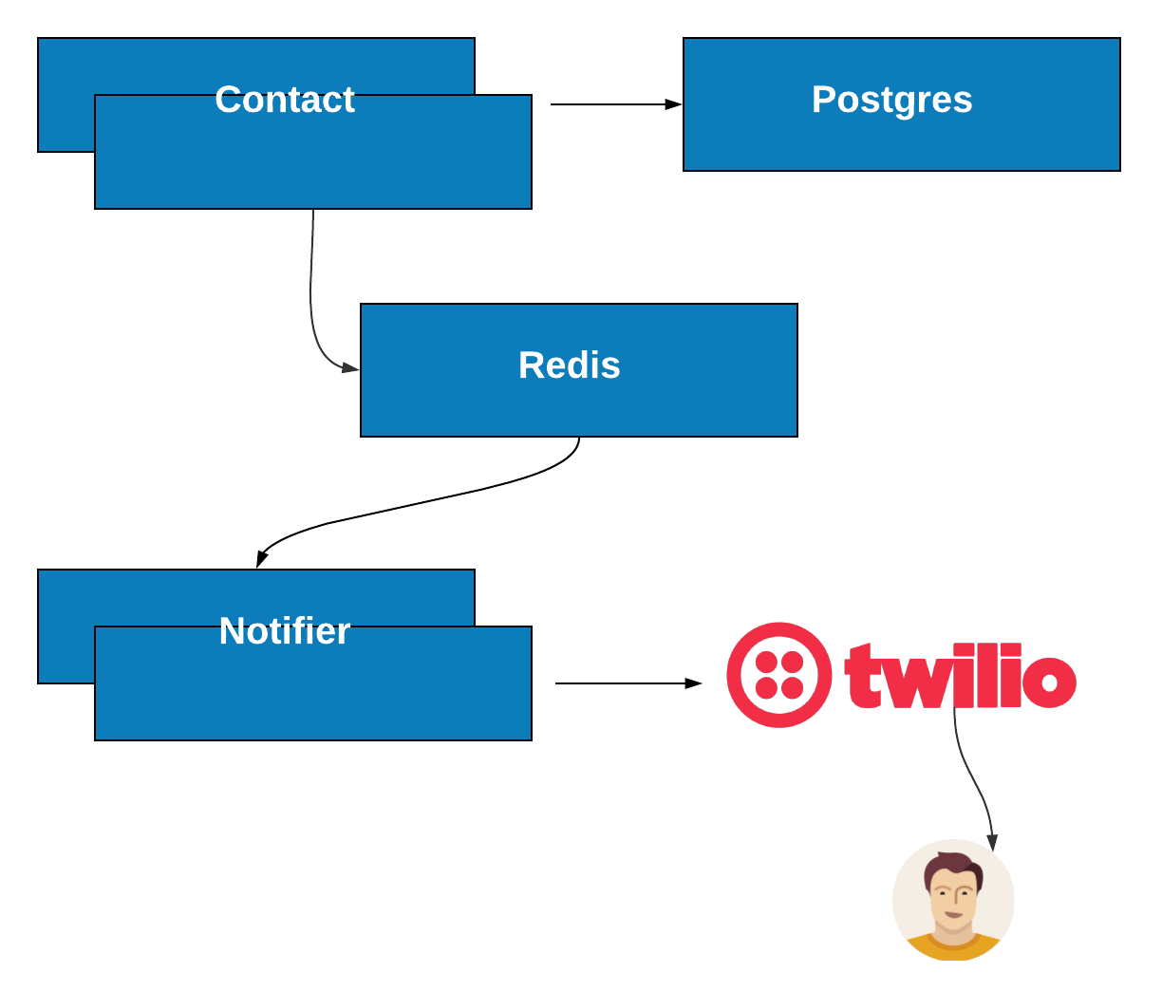
The real power of Docker comes when standing up the entire stack
The real power of Docker becomes apparent when you have to build a real application with real infrastructure.
We are going to build a text-to-speech application
This application will involve multiple pieces of infrastructure:
2 Python-based services
1 Postgres Database
1 Redis Service
A call out to Twilio
We want to build and deploy the exact same environment we run locally to a prod environment.

Slide 20
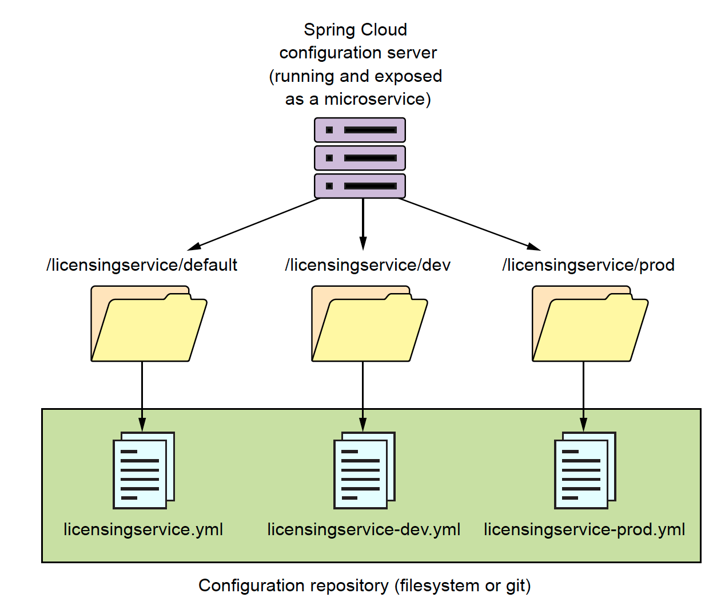
Anatomy Spring Cloud Config
Spring Cloud Config is a configuration repository for holding service data
As a Spring Boot service starts it will pull down the configuration from the Spring Cloud Config service
Spring Cloud Config
Is exposed as REST-based microservice
Integrates tightly with Spring properties
Supports multiple data stores (Consul, Eureka, GitHub)
Supports encryption of sensitive properties
Dynamic refreshing of properties
Ensures that every instance of a service that boots will have the exact same configuration
Configuration management is a critical part of any service management environment
Notes:
One of my personal favor repositories is using github. You automatically get versioning for deployment options.

Slide 21
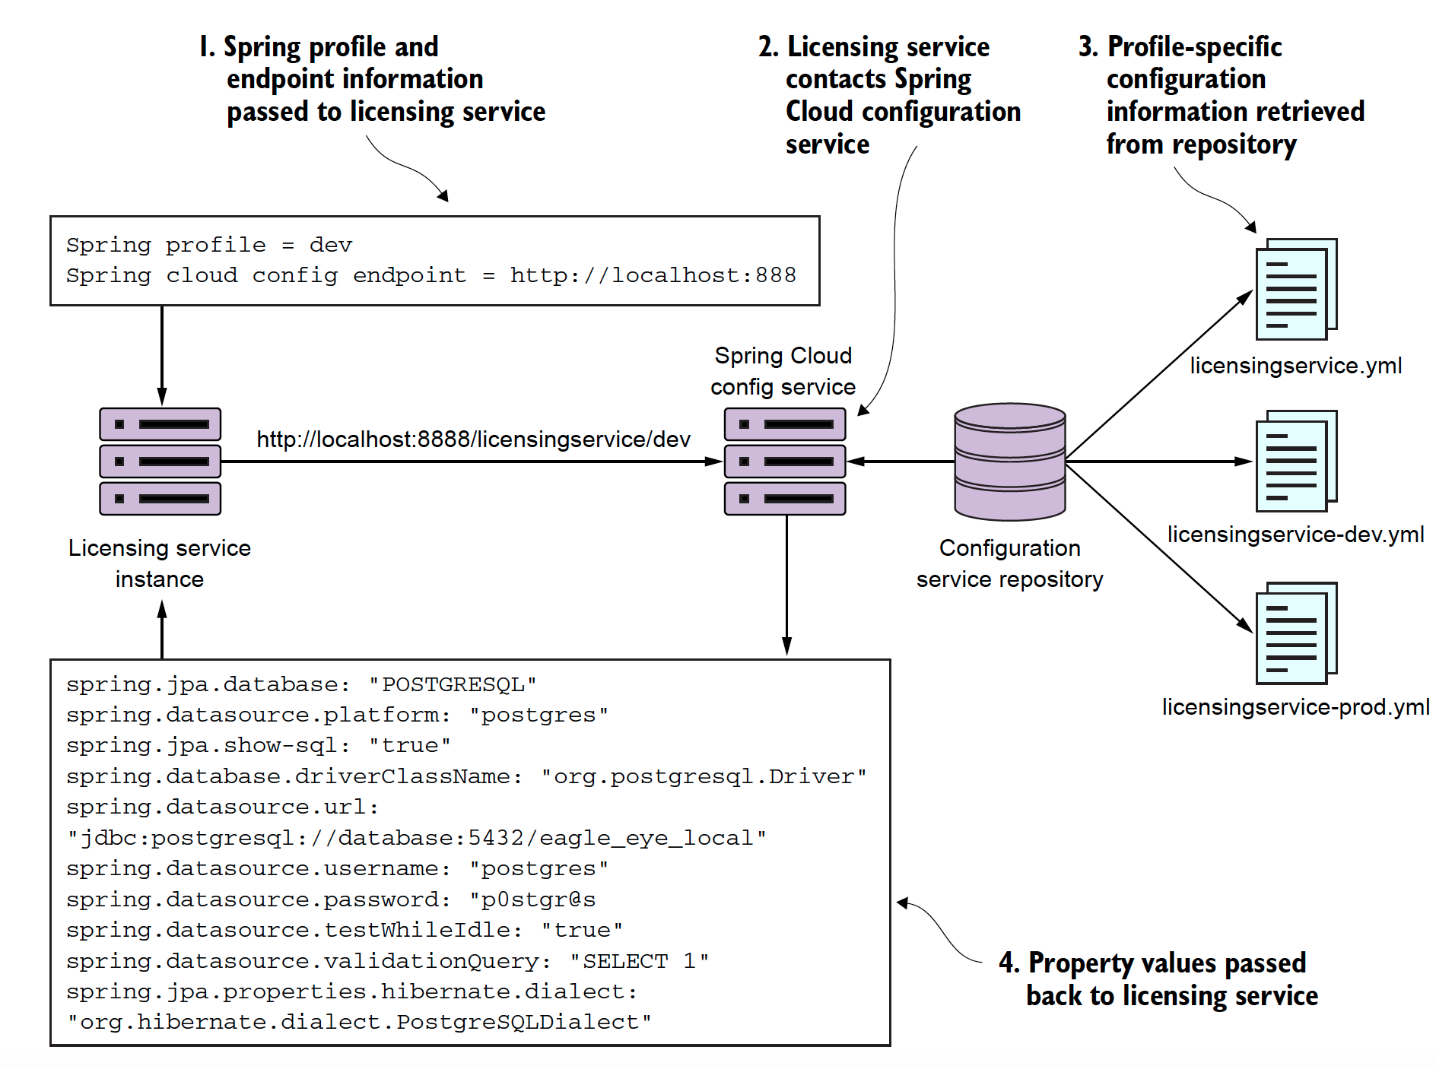
Spring Cloud Config in Action
Notes:
Lets go look a the code.

Slide 22
Service discovery and routing with Spring Cloud, Netflix Eureka and Zuul

Slide 23
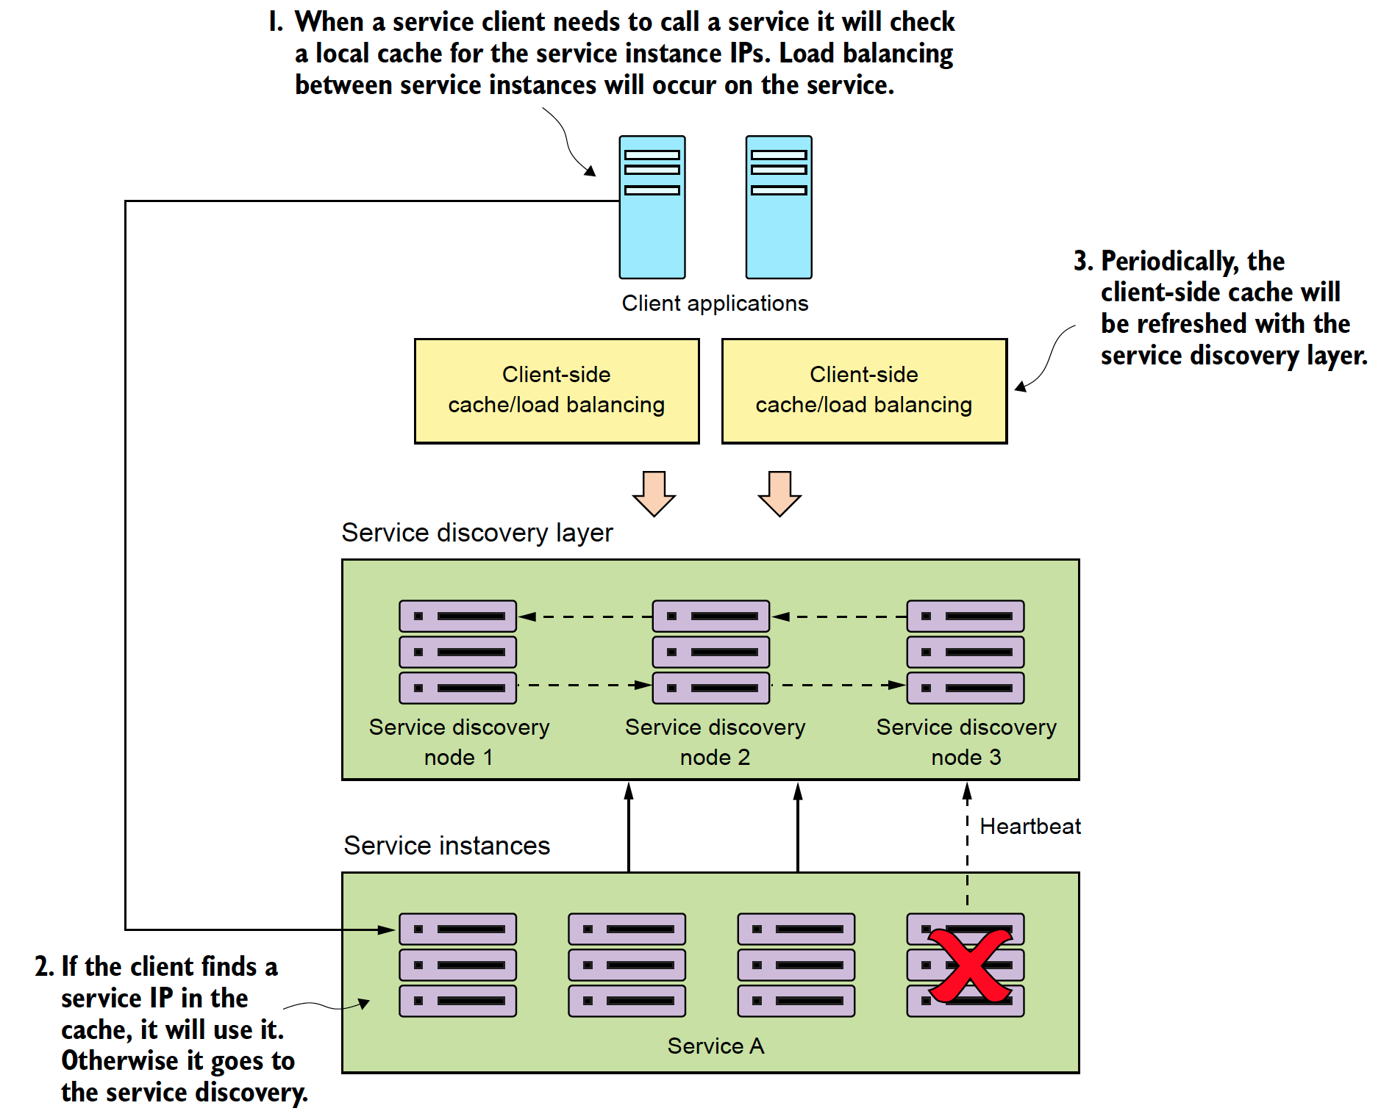
Service Discovery: Finding Your Service
Service discovery is the mechanism in which clients locate an instance of a service.
Service registration
Client lookup
Health monitoring
Resiliency and redundancy
Notes:
The important thing to note with service discovery is that it allows you to spin up large number of services quickly without a client having to explicitly know about them. This is huge because it allows you to scale quickly.
- Not just for performance reasons
- I have spent many years during a critsit wishing I could quickly spin up new instances of web sphere services

Slide 24
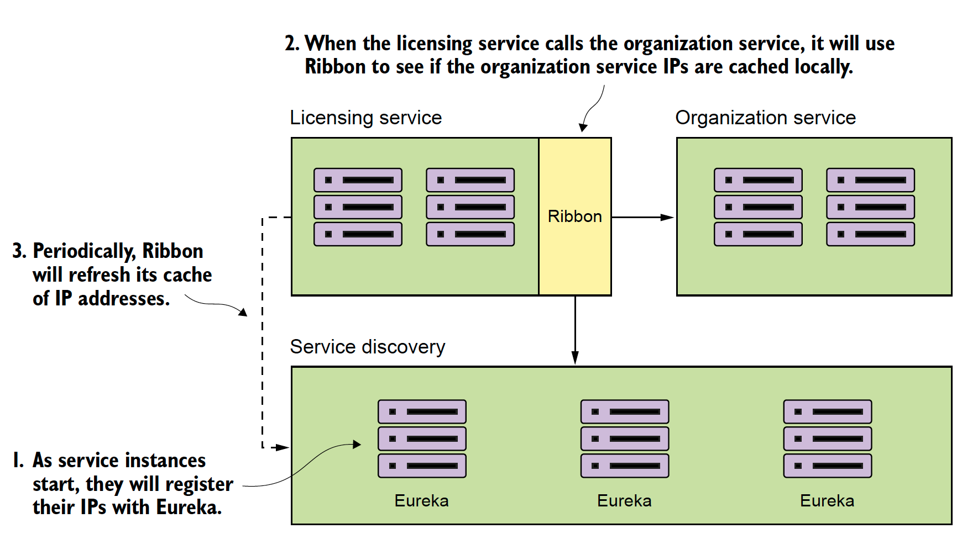
Feign and Ribbon: How a Spring client finds a service
Notes:
Lets look at some code

Slide 25
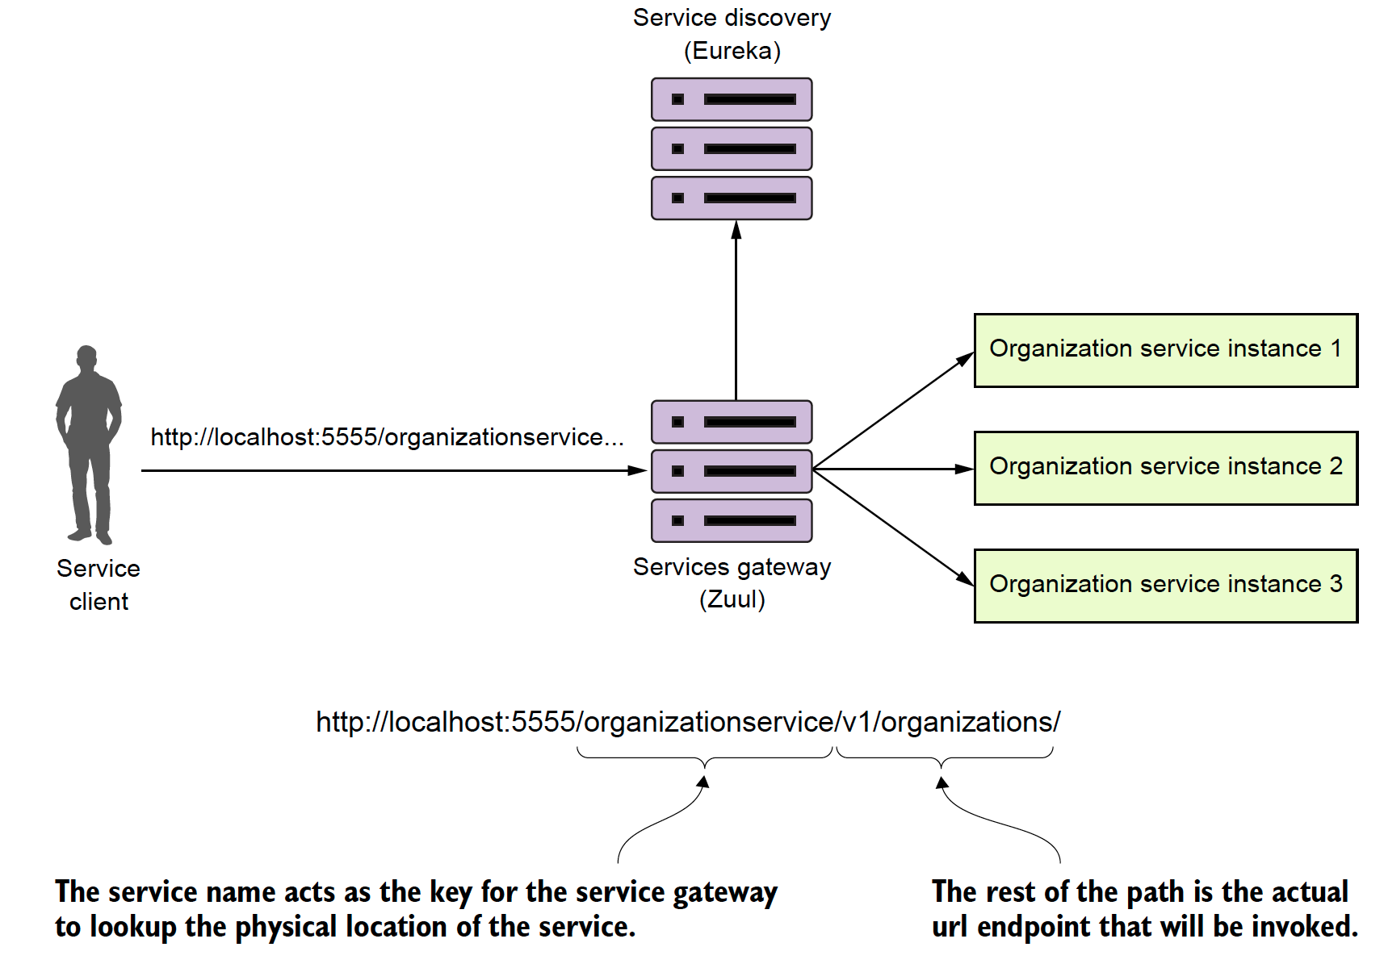
Spring Cloud and Zuul: Building a service gateway
A service gateway acts an intermediary between the service client and the service.
Service client has a single URL to invoke.
Service gateway acts as a traffic cop.
Service gateway acts as a Policy Enforcement Point (PEP)
Static routing
Dynamic routing
Authentication/Authorization
Metric collection, rate limiting
Notes:
Zuul is a very cool technology. it allows you to proxy requests and it allows you to do pre-post filters along with dynamic routing. Uses of include:
1. Custom security and policy enforcement (every call must have certain headers).
2. Header and content manipulation. (Correlation id injection
3 Content manipulation anddynamic routing

Slide 26
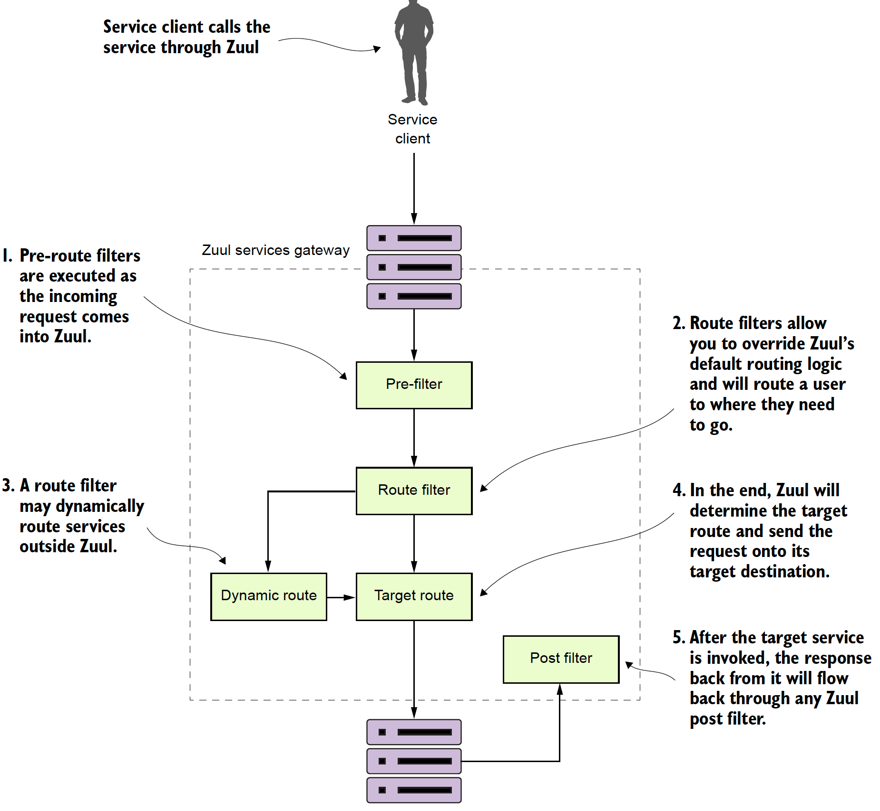
Spring Cloud: Policy Enforcement

Slide 27
Client-side resiliency with Spring Cloud and Hystrix
Notes:
For about 5 years I did

Slide 28
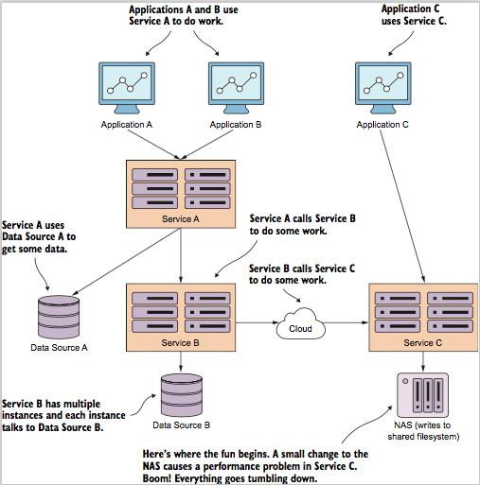
Ever have one of those days?
Bad things happen, but they really happen in truly spectacular fashion
In distributed systems, outages are more often then not caused by degradation of a component.
Client resiliency patterns help protect the clients consuming a service.
They also help a service that is running in a degraded state by taking pressure off the system.

Slide 29
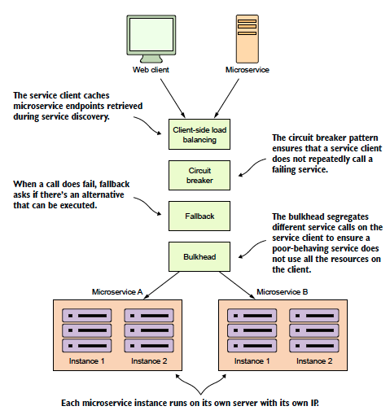
Spring Cloud and Hystrix

Slide 30
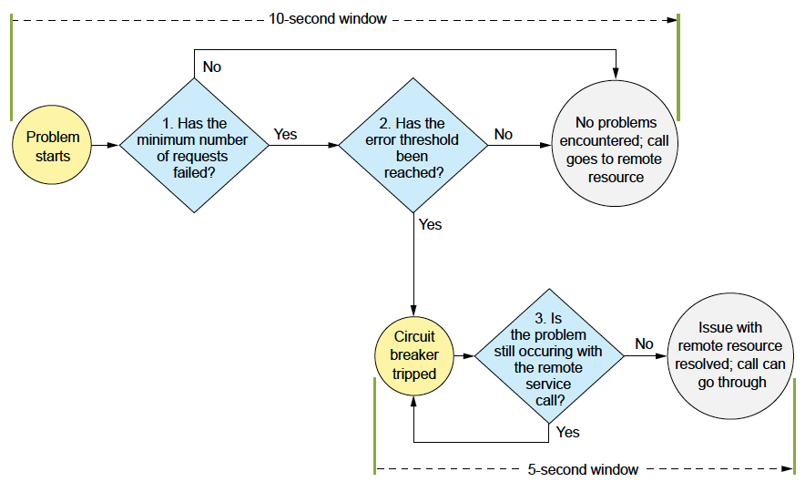
Popping a circuit on a bad call

Slide 31
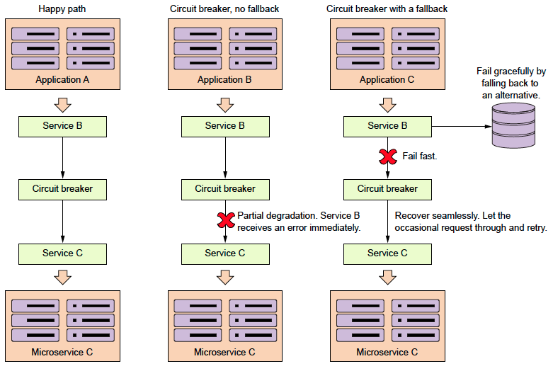
Always have a plan b: Fallback’s in Hystrix

Slide 32
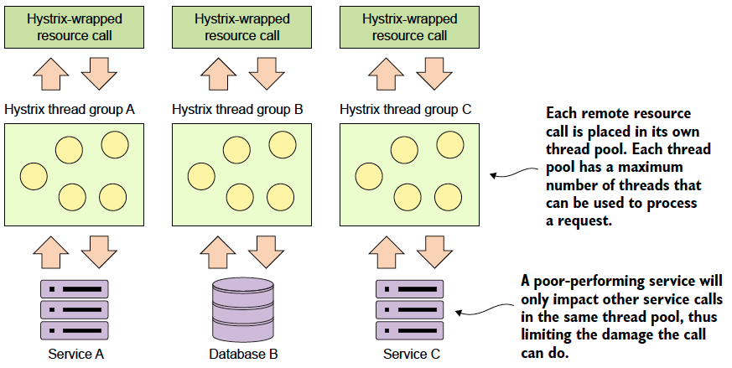
Saving the ship with bulkheads

Slide 33
Event driven microservices with Spring Cloud Stream

Slide 34
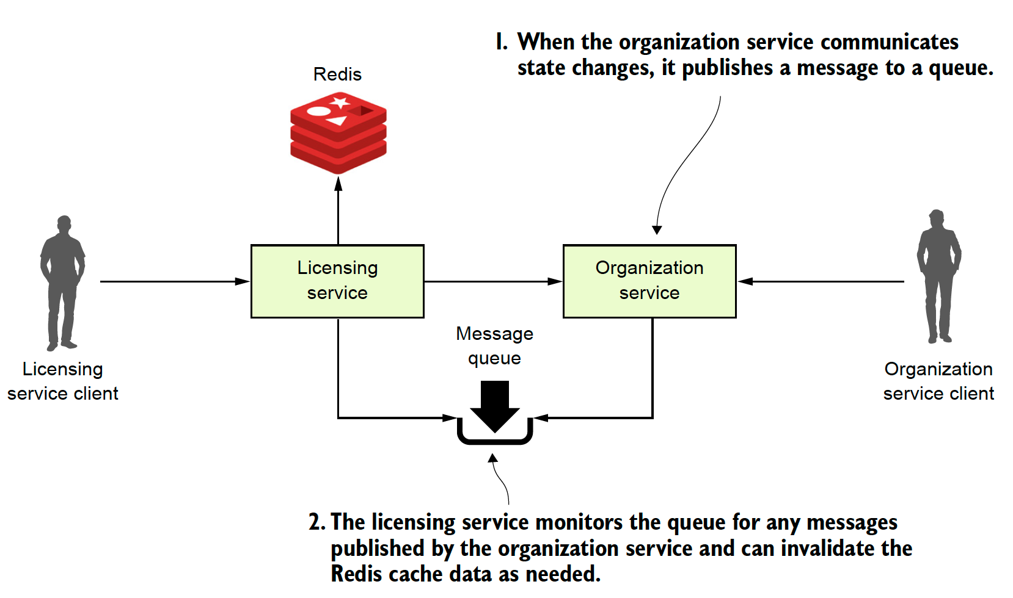
Event Driven Architecture with Spring Cloud Stream
Notes:
This is going to be a simple example and you might ask why I dont use Spring Cache.

Slide 35
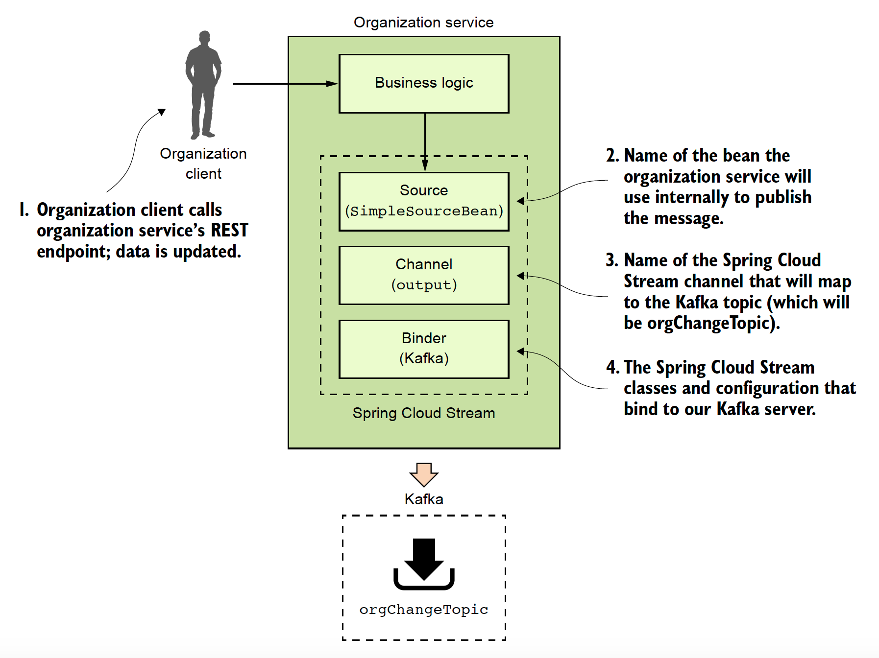
Spring Cloud Stream: Message Producer

Slide 36
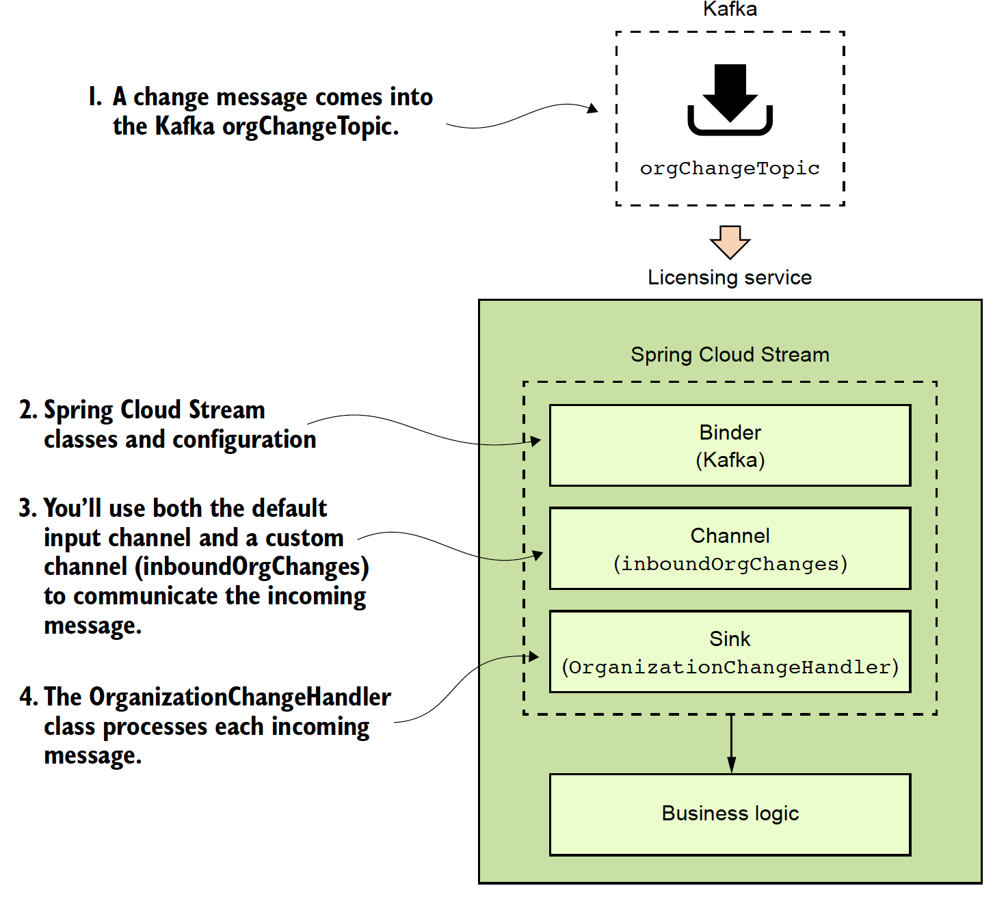
Spring Cloud Stream: Message Consumer

Slide 37
Distributed service tracing with Spring Cloud Sleuth
Notes:
Microservice architectures are great because they break everything down into small pieces. Microservice architectures are extremely painful to debug because they break everything down into small pieces (especially if you have multiple teams). Log correlation, aggregation and tracing are critical to the success of your application because when u need logging (eg. critsits) is often when you dont have it.). We are going to look at how we can use Spring Cloud Sleuth with tools like Papertrail and Zipkin

Slide 38
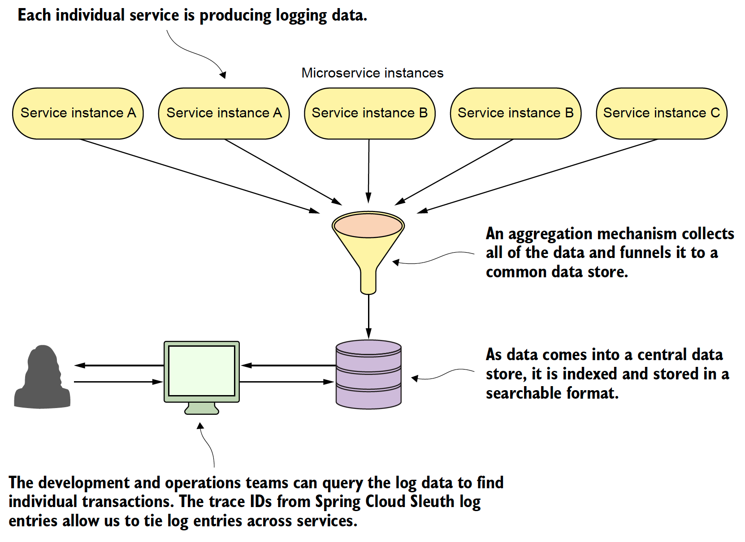
Log Aggregation and Distributed Tracing
Notes:
Log aggregation

Slide 39
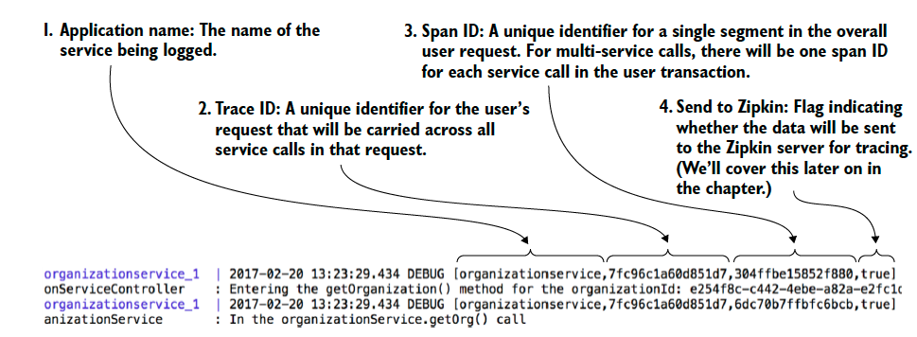
Step 1: Setting up Spring Cloud Sleuth
<dependency> <groupId>org.springframework.cloud</groupId> <artifactId>spring-cloud-stream</artifactId> </dependency>
Notes:
Spring Cloud sleuth really does a lot of behind the scenes magic with generating trace ids (correlation ids) and then making sure each segment of a call is broken down in a unique span.

Slide 40
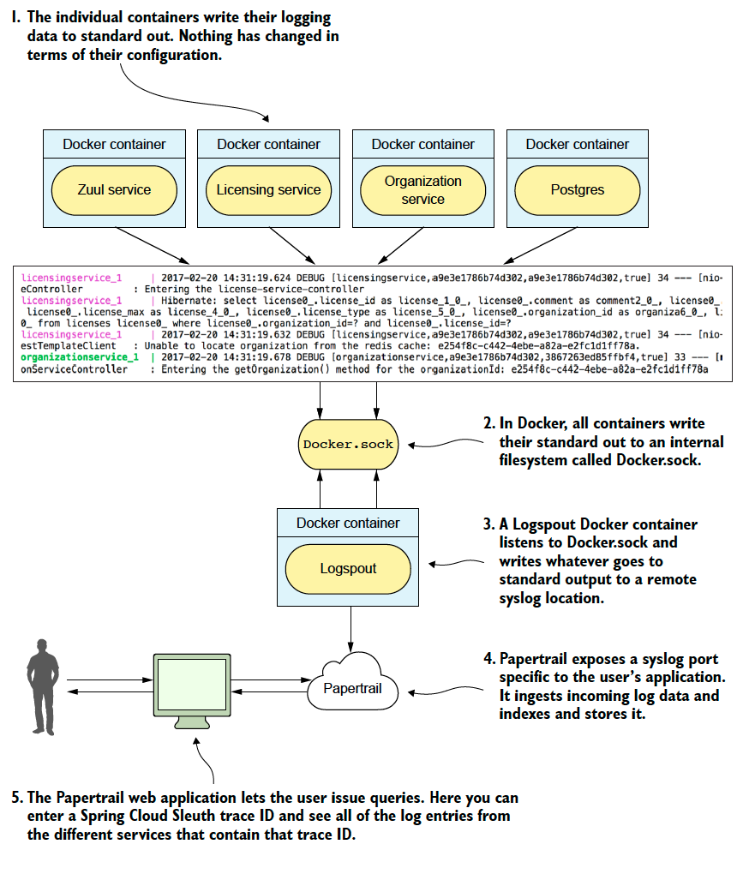
Step 2: Log Aggregation with Spring Cloud Sleuth and Papertrail
Notes:
Papertrail is just one log aggregation tool

Slide 41
Step 3: Integrating Spring Cloud Stream with Zipkin
spring:
zipkin:
baseUrl: localhost:9411 <-Change to the URL of your Zipkin service

Slide 42
Closing Thoughts

Slide 43
Closing thoughts
Spring Cloud has a large number of parts and is growing:
What we did not cover
Spring Cloud Security
Microservice Deployment
Spring Cloud with AWS
Spring Cloud Data Flow
Spring Cloud Contract
Beyond microservices
Lambdas
Functions as a Service (FaaS)

Slide 44
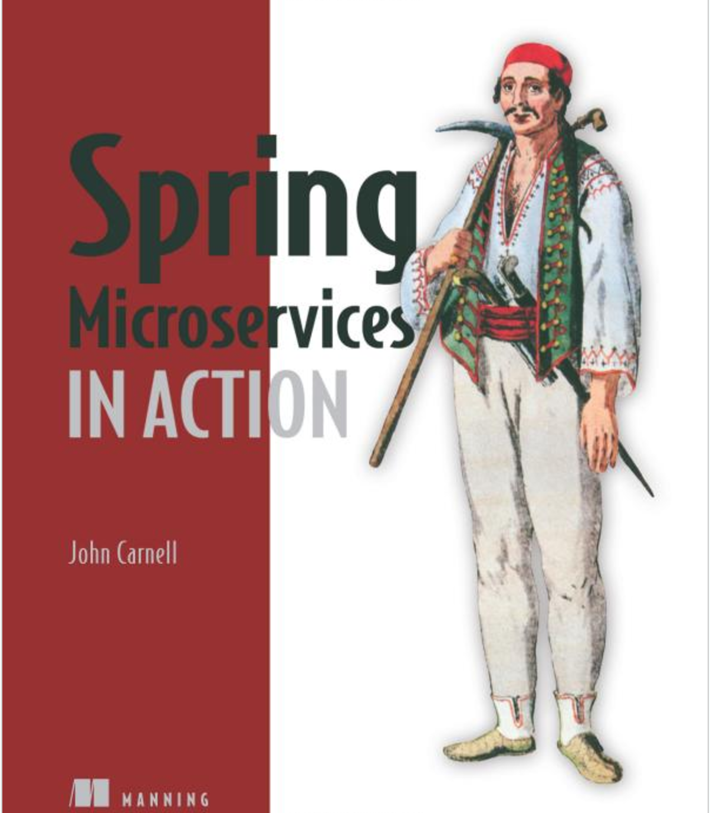
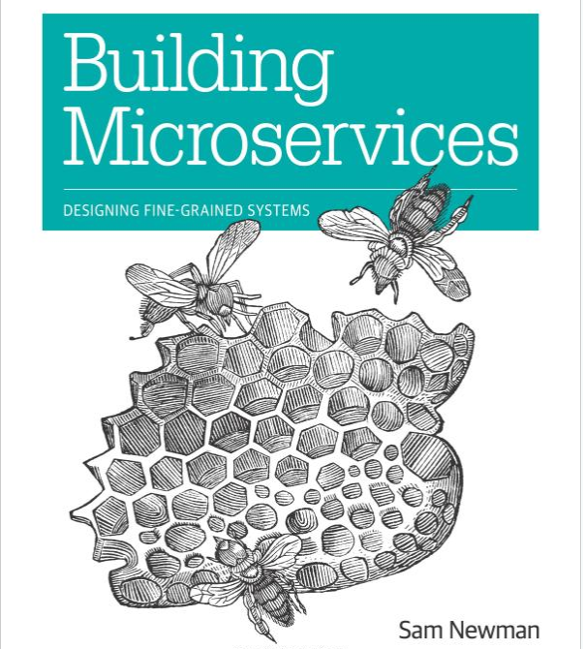

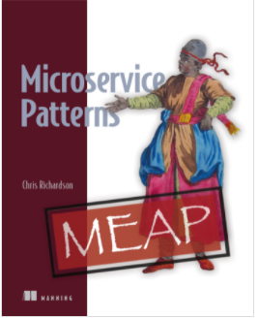
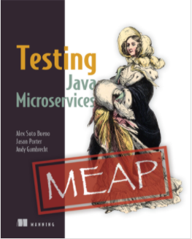
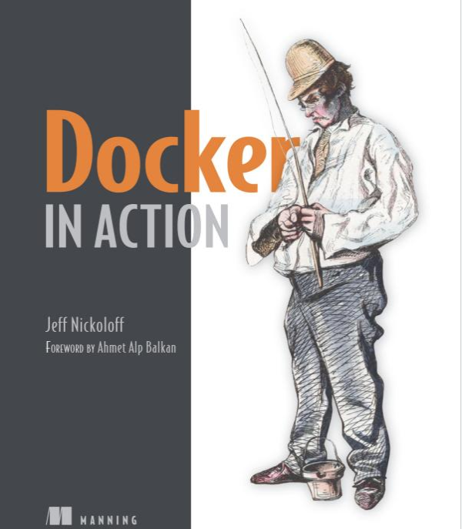
Other Microservice Resources

Slide 45
Questions

